Slide 1




JIS
JUDICIARY INFORMATION SYSTEM
PRESENTATION

Slide 2




PROBLEM STATEMENT
The Attorney General's Office seeks the development of a Judiciary Information System (JIS) to manage court cases efficiently and provide easy access to past case details. Each case is identified by a unique number and includes defendant information, crime specifics, and hearing schedules. The system allows querying pending and resolved cases, upcoming hearings, and case statuses. Judges and lawyers can access past cases, with lawyers being charged for each access. The system also enables user management and tracks lawyer usage for billing purposes.

Slide 3


TECHSTACK
front-end
Backend
database
ReactJS
BootStrap
Redux
ExpressJS
NodeJs
MongoDB Atlas

Slide 4
ACTORS
registrar
Judge
Lawyer

Slide 5


LINKS
1
Hosted Website
WEBSITE
2
Frontend repository
CODE
3
Backend repository
CODE

Slide 6

REGISTRAR

Slide 7
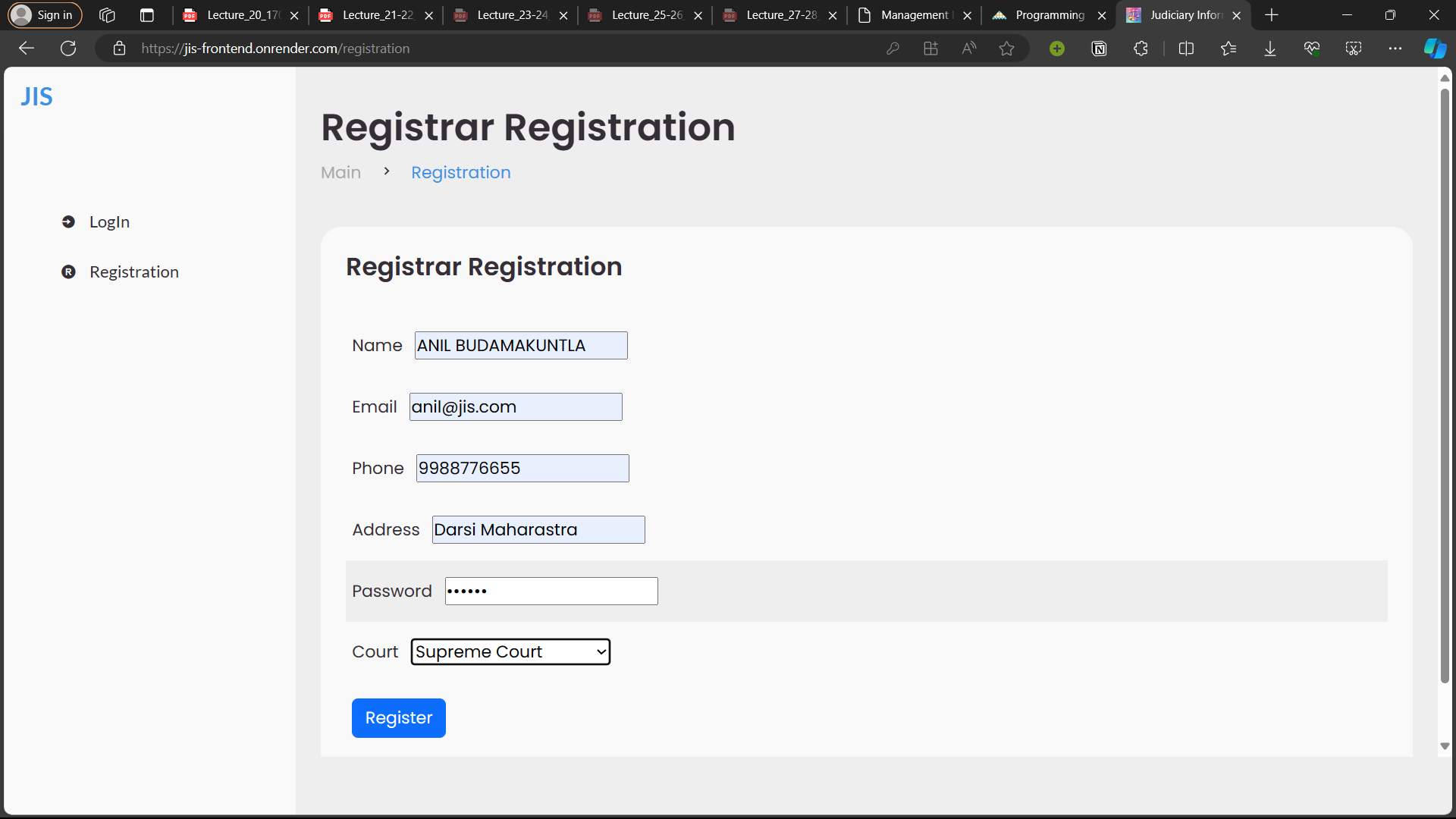
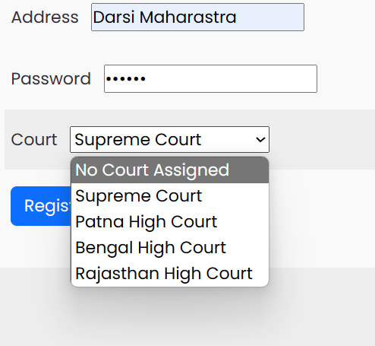

REGISTRATION

Slide 8
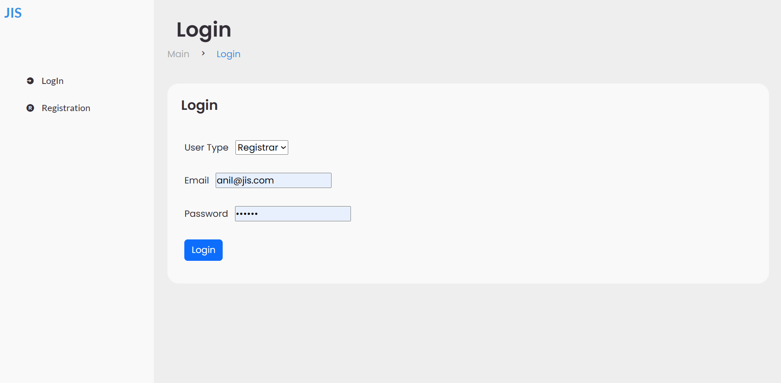
LOGIN

Slide 9
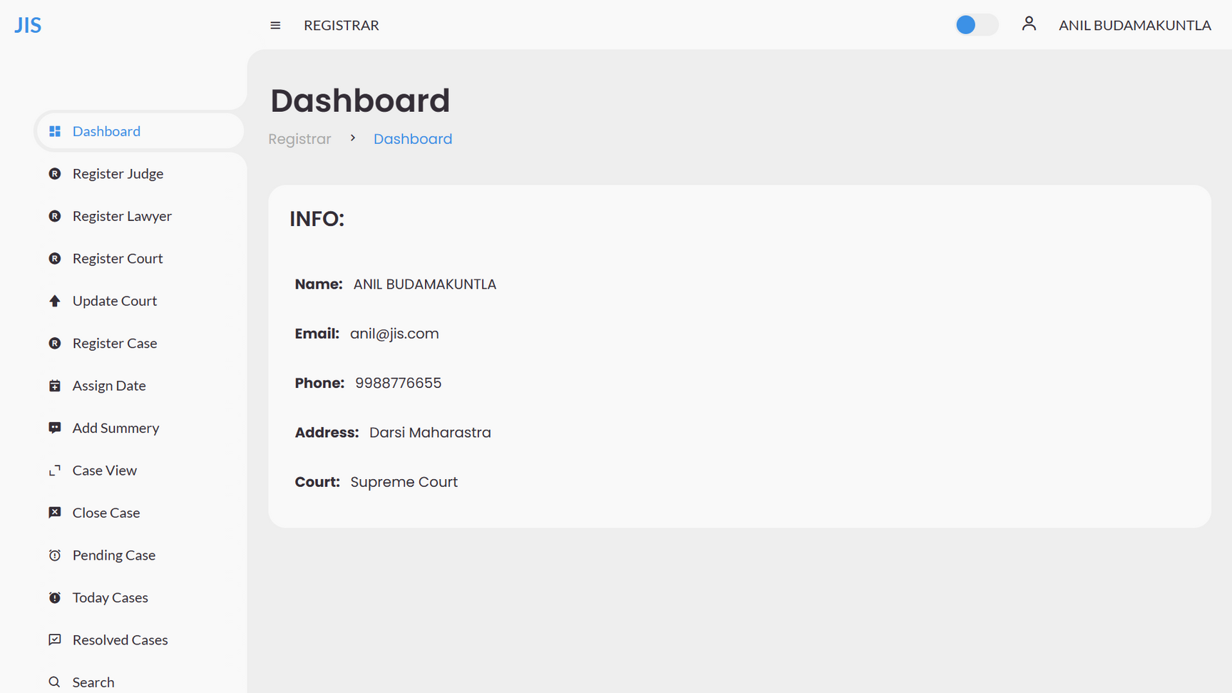
DASHBOARD

Slide 10
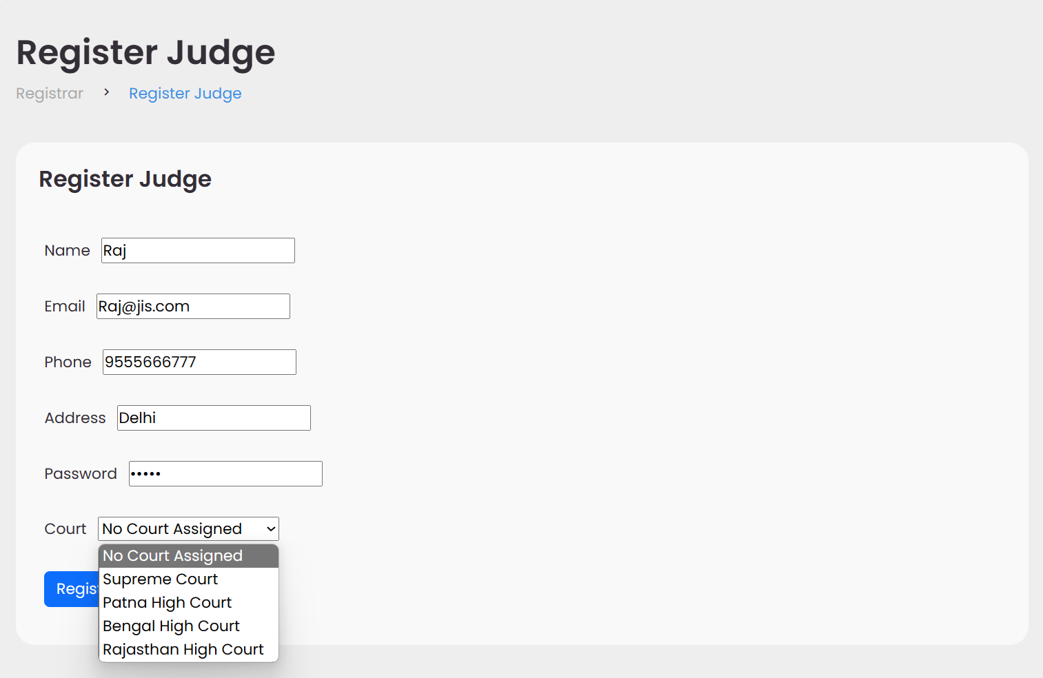
JUDGE REGISTRATION

Slide 11
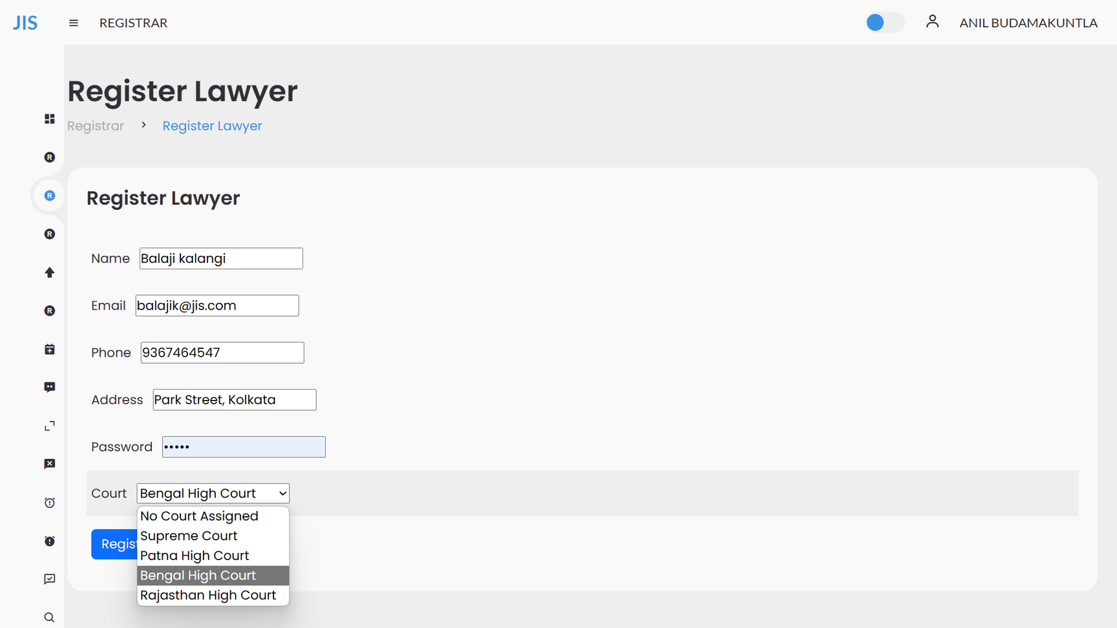
LAWYER REGISTRATION

Slide 12
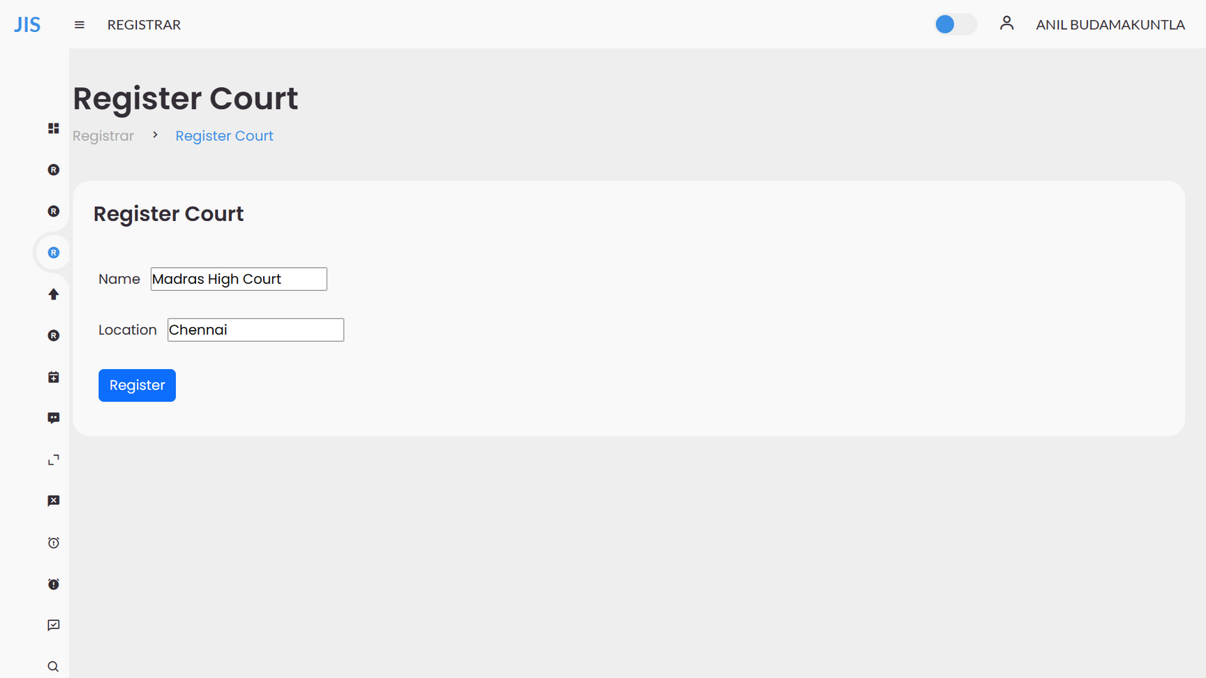
COURT REGISTRATION

Slide 13
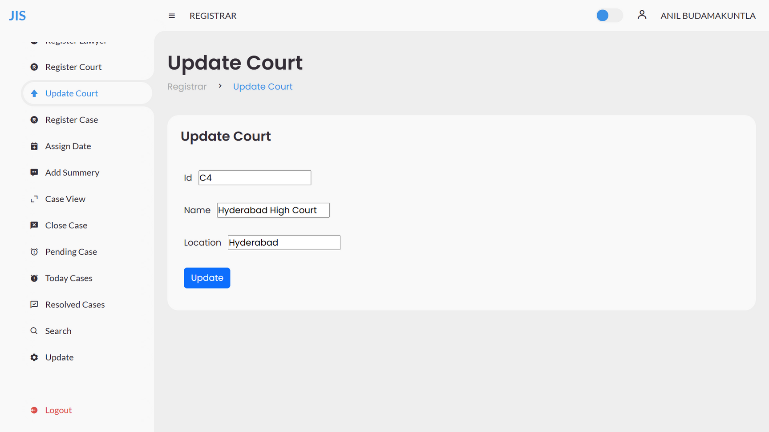
UPDATE COURT DETAILS

Slide 14
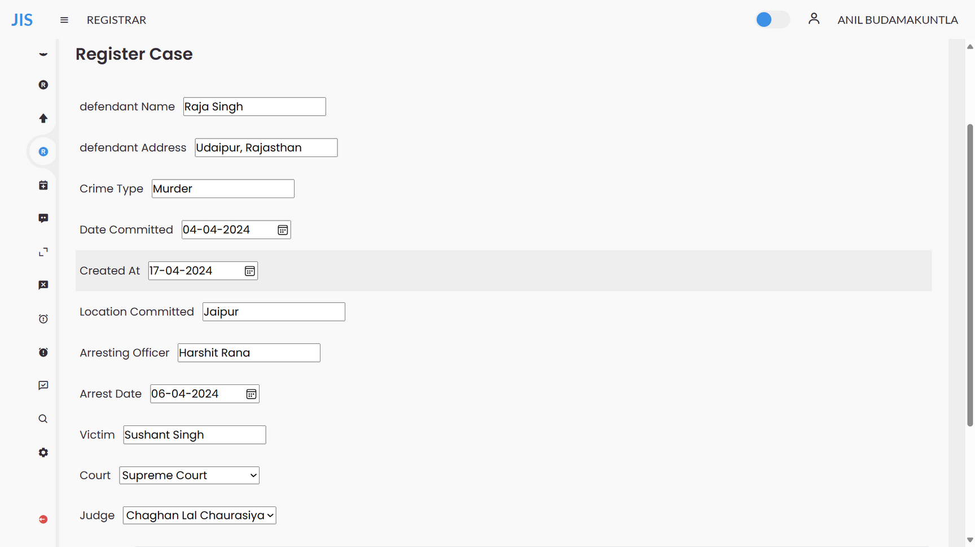
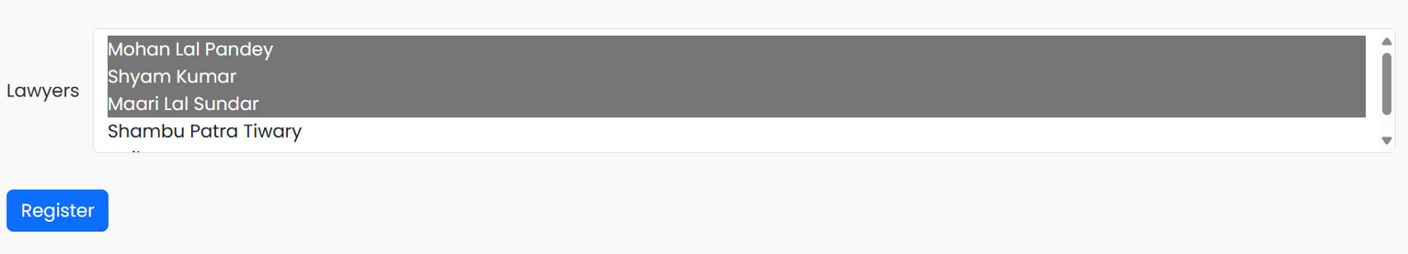
CASE REGISTRATION

Slide 15
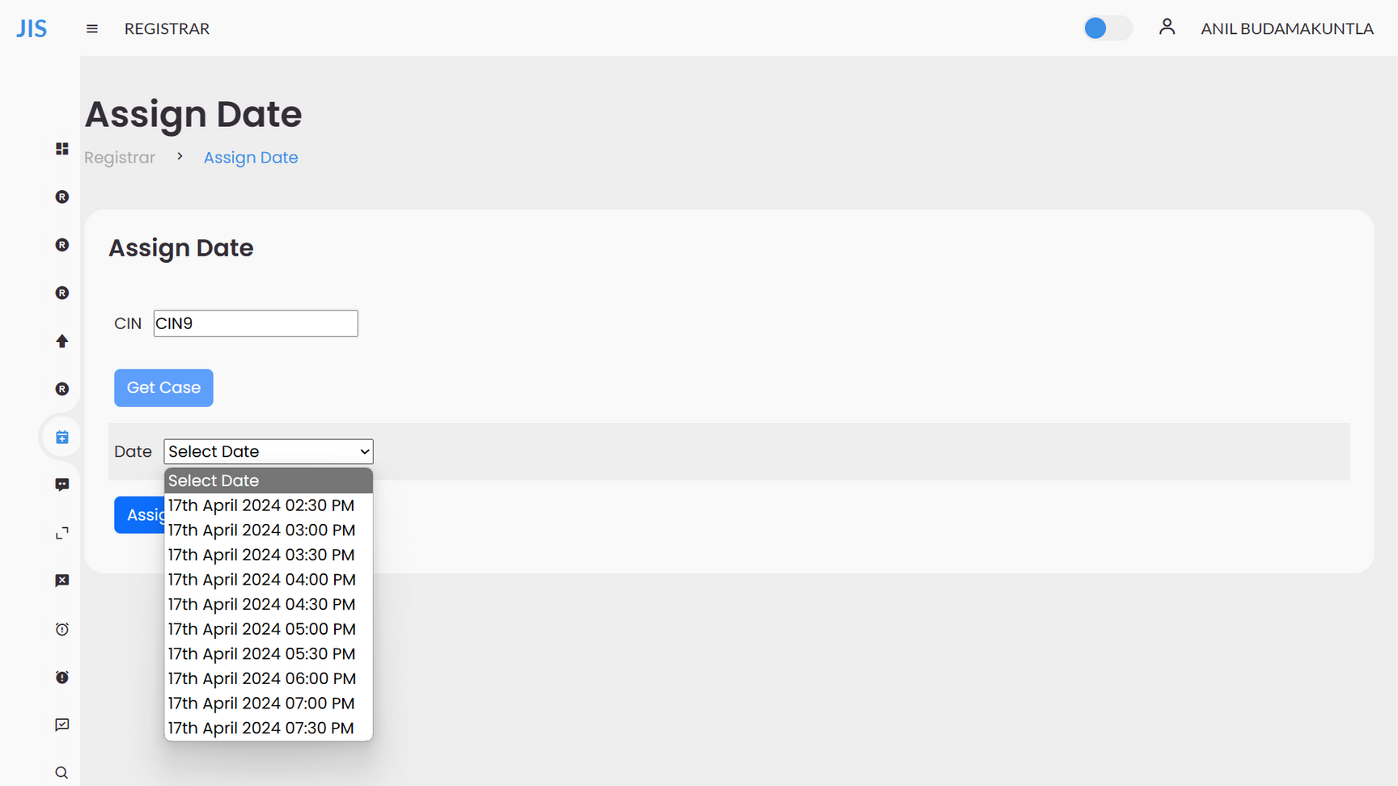
ASSIGNING DATES FOR CASE

Slide 16
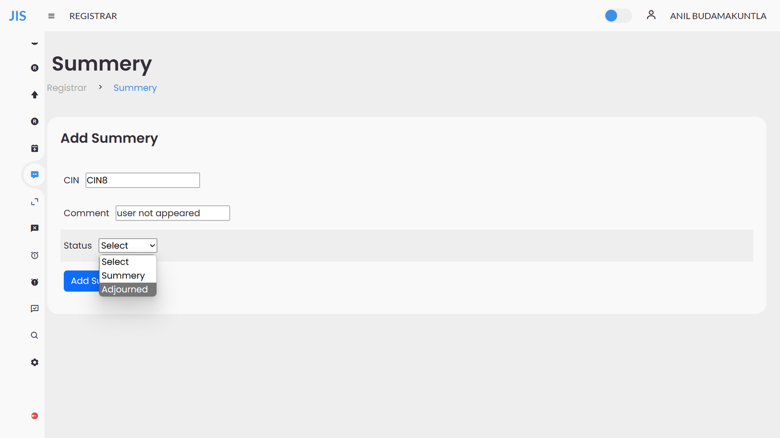
CASE SUMMERY

Slide 17
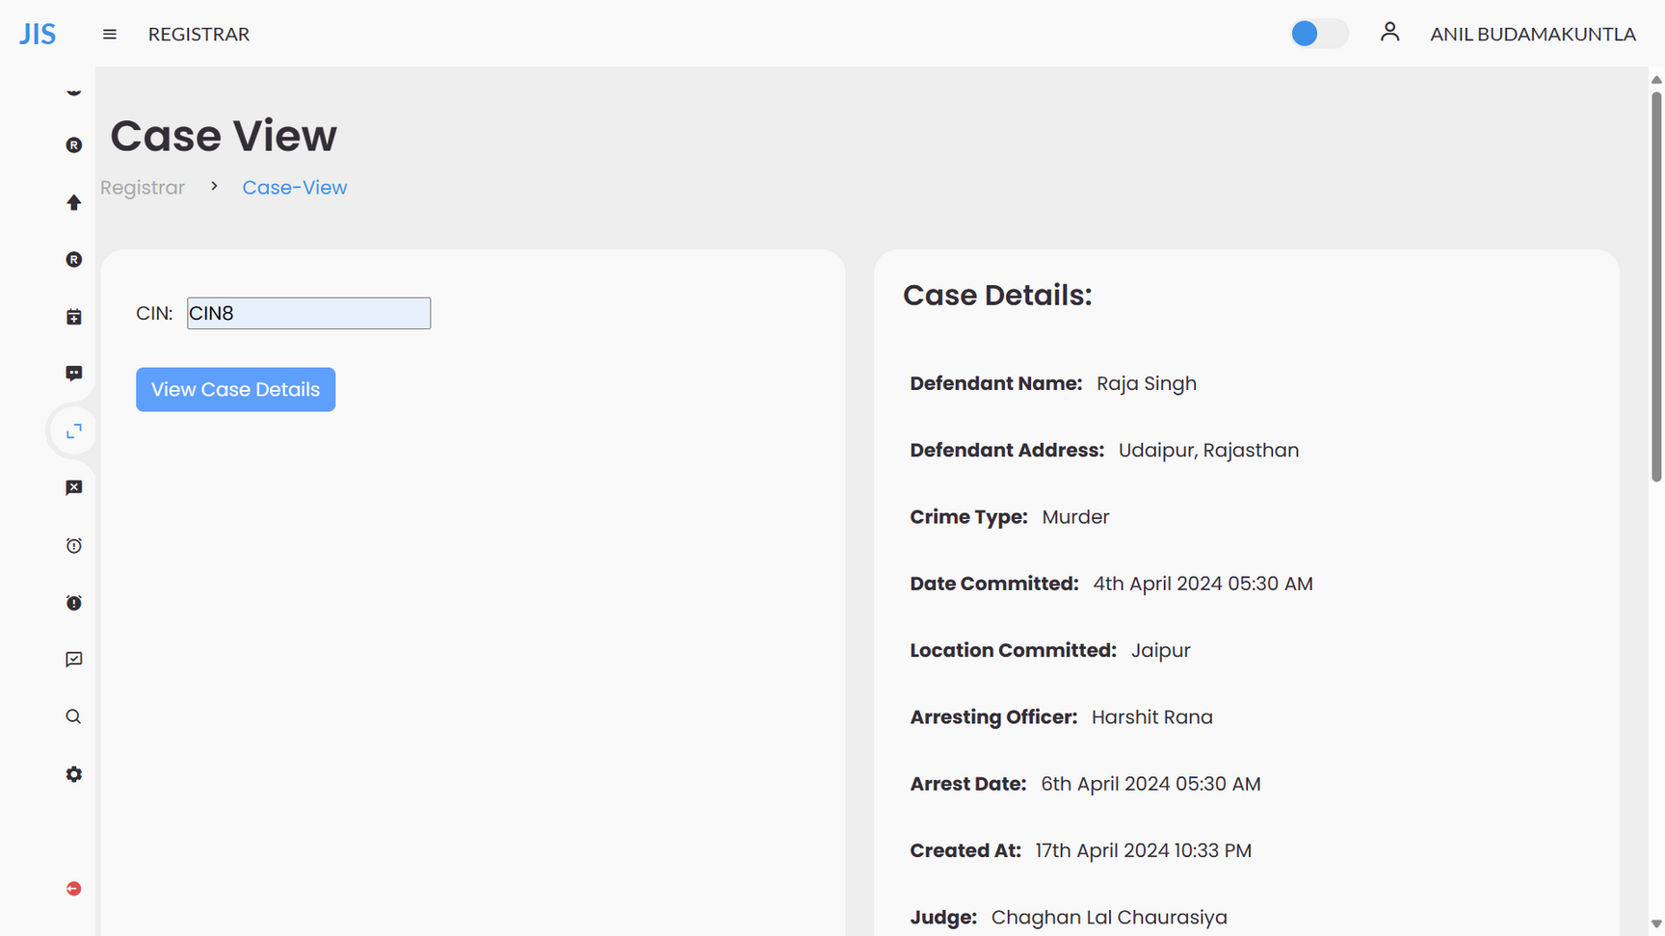
CASE DETAILS

Slide 18
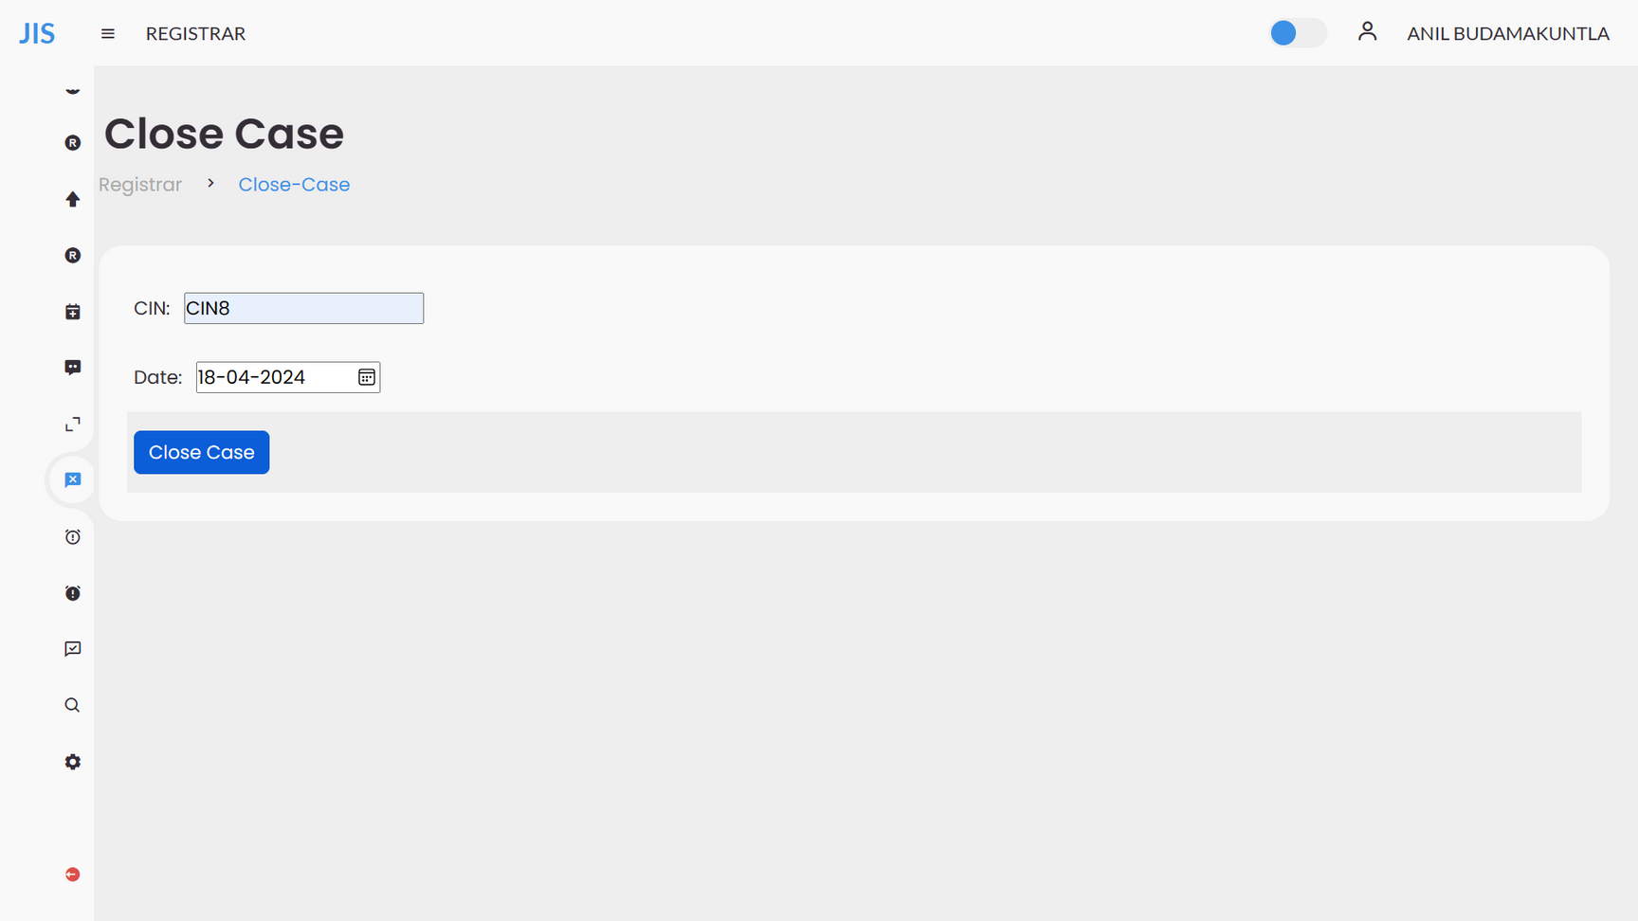
CLOSING CASE

Slide 19
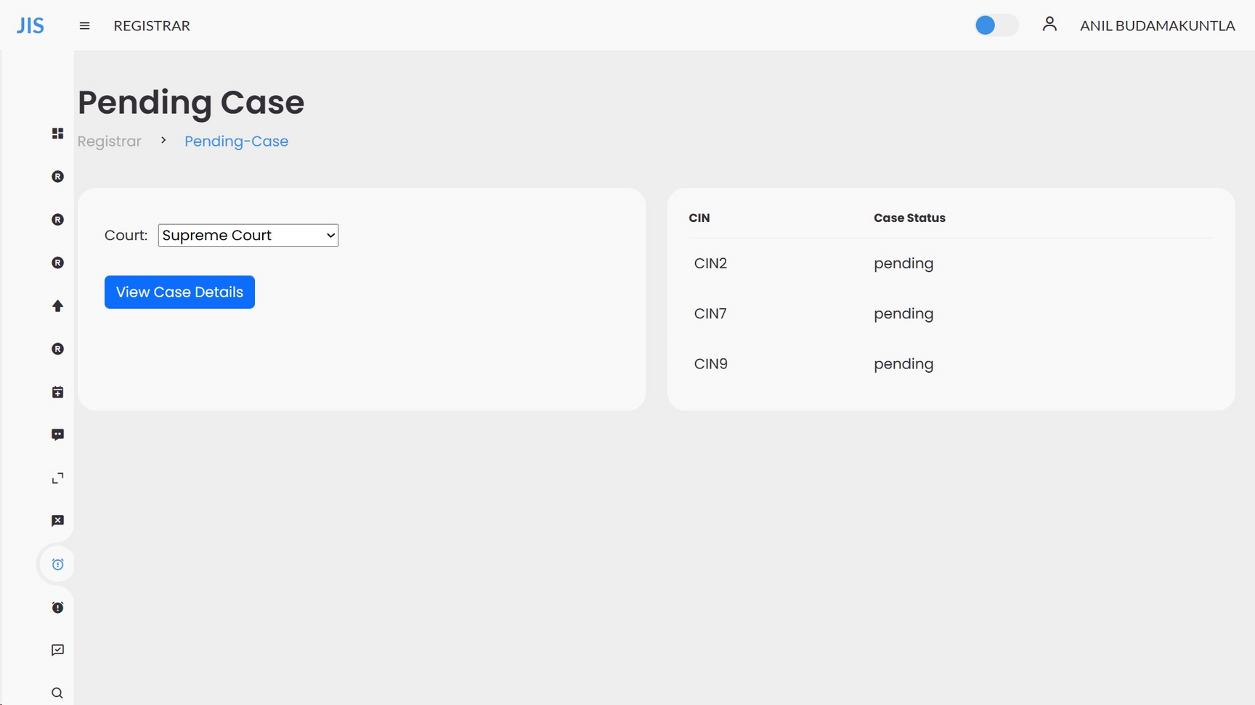
PENDING CASE

Slide 20
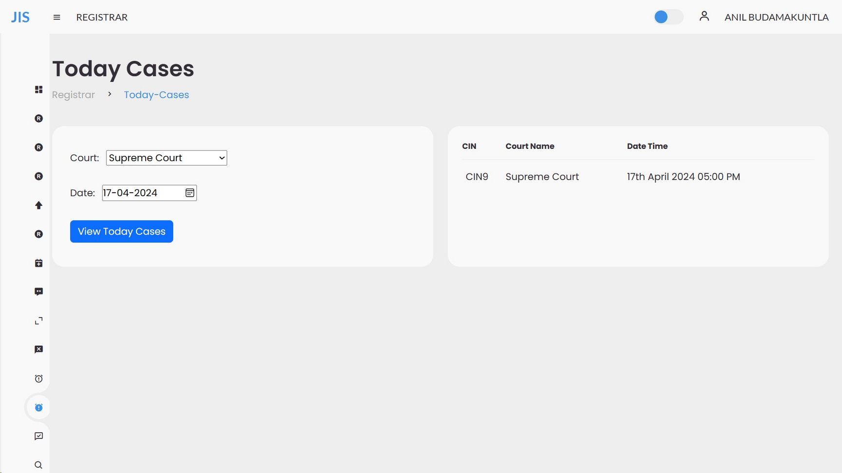
TODAY’S CASE

Slide 21
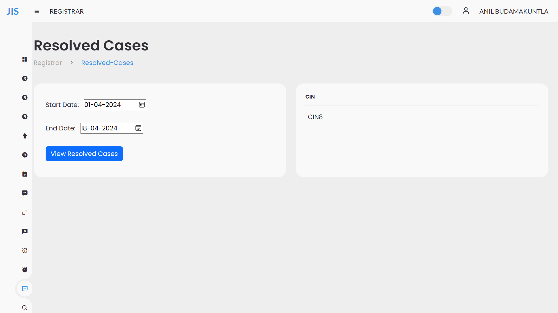
RESOLVED CASES

Slide 22
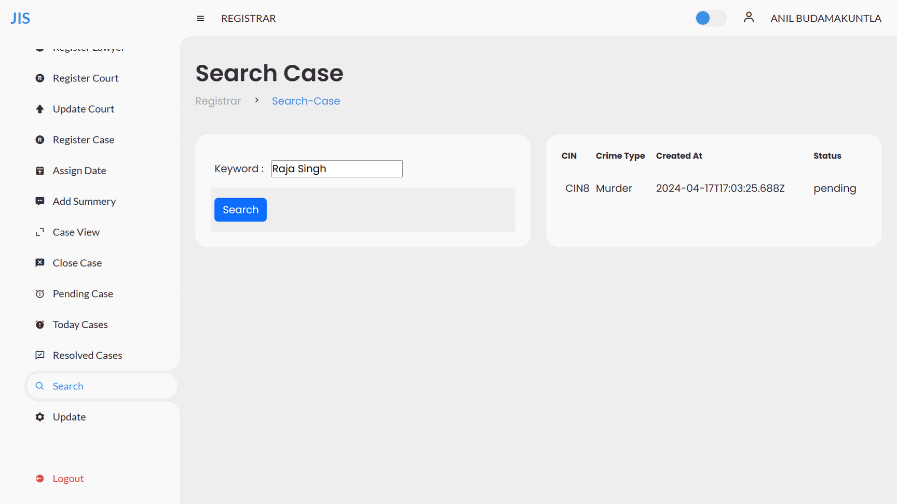
SEARCH CASE

Slide 23
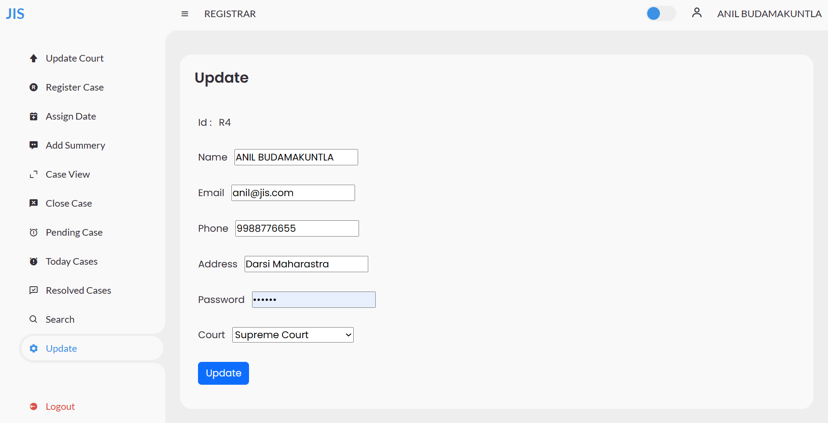
REGISTRAR UPDATION

Slide 24
LAWYER

Slide 25
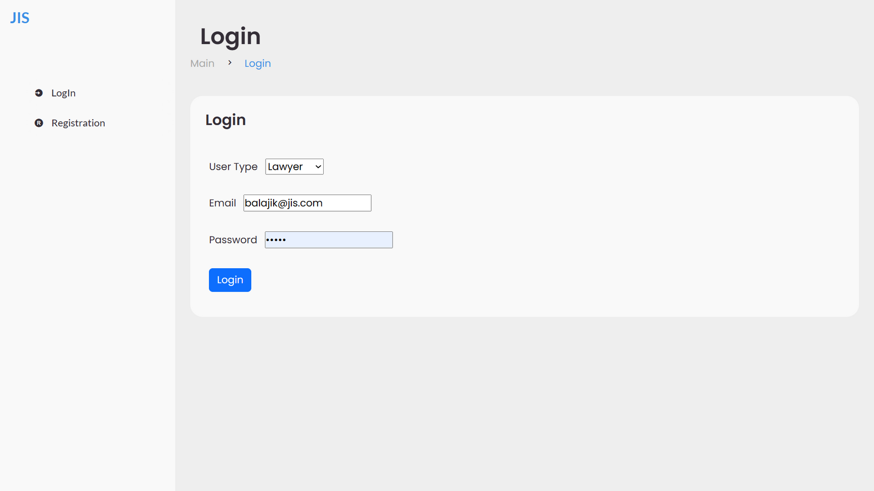
LAWYER LOGIN

Slide 26
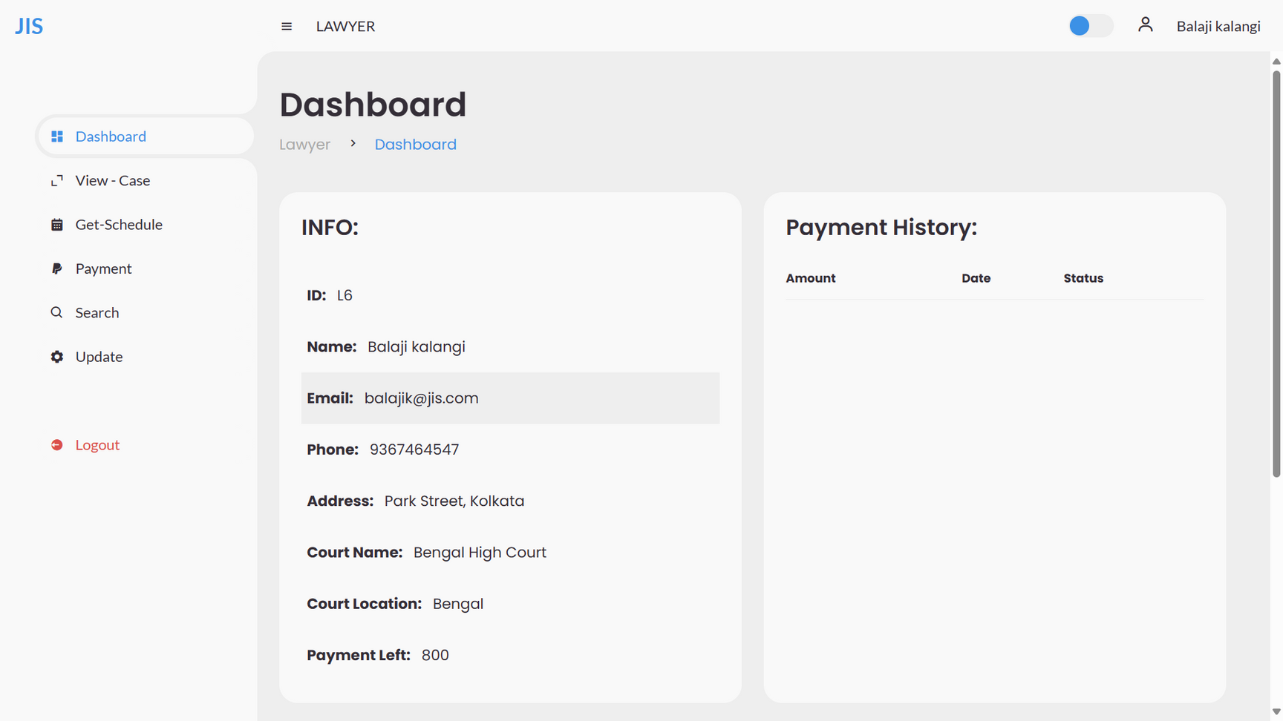
LAWYER DASHOARD

Slide 27
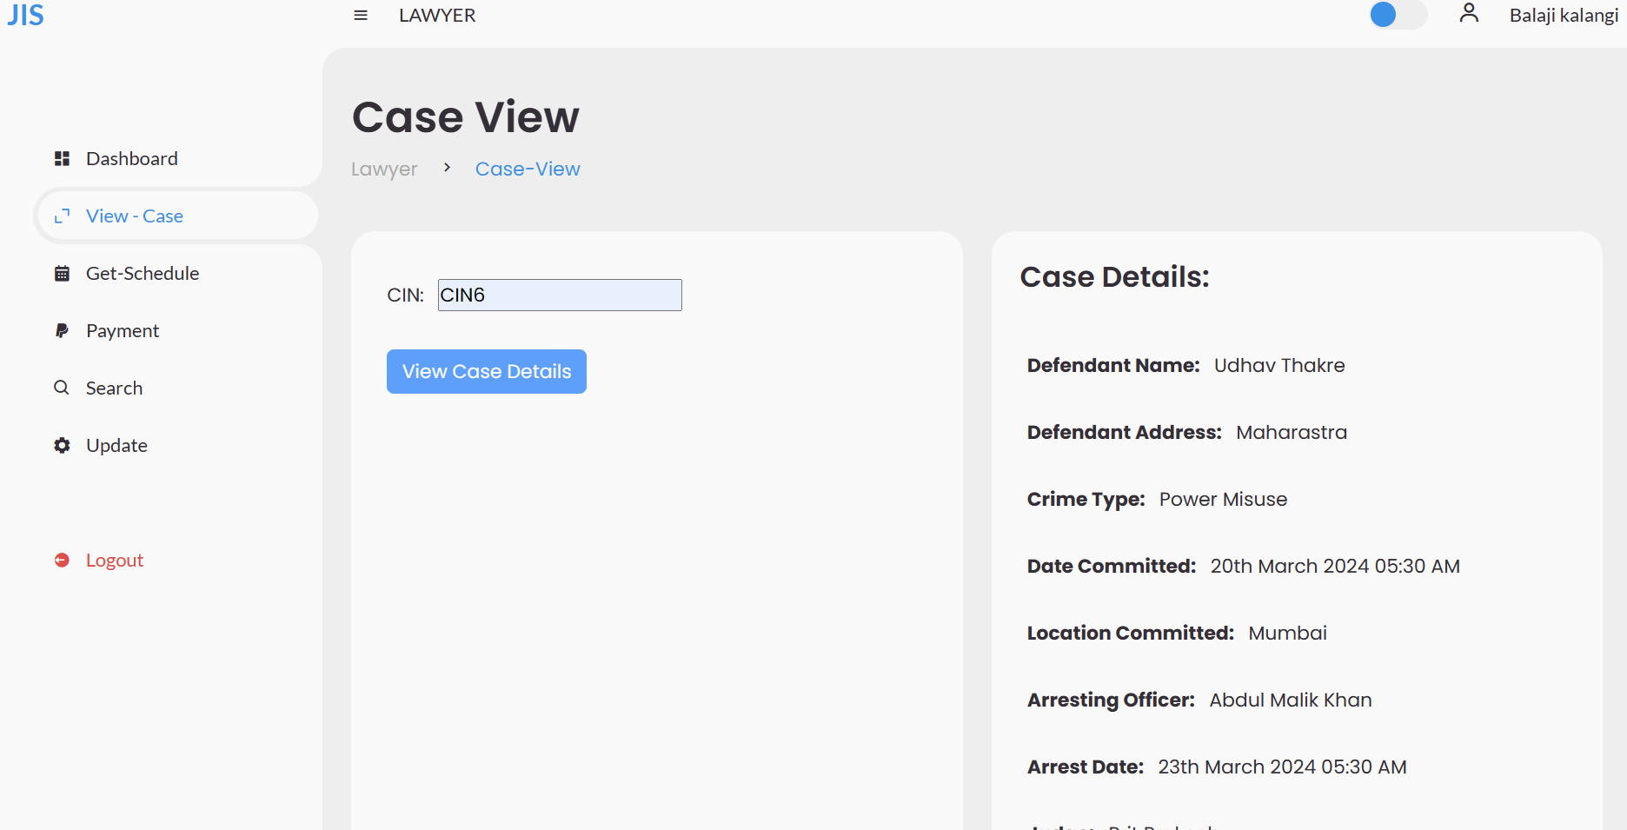
CASE VIEW

Slide 28
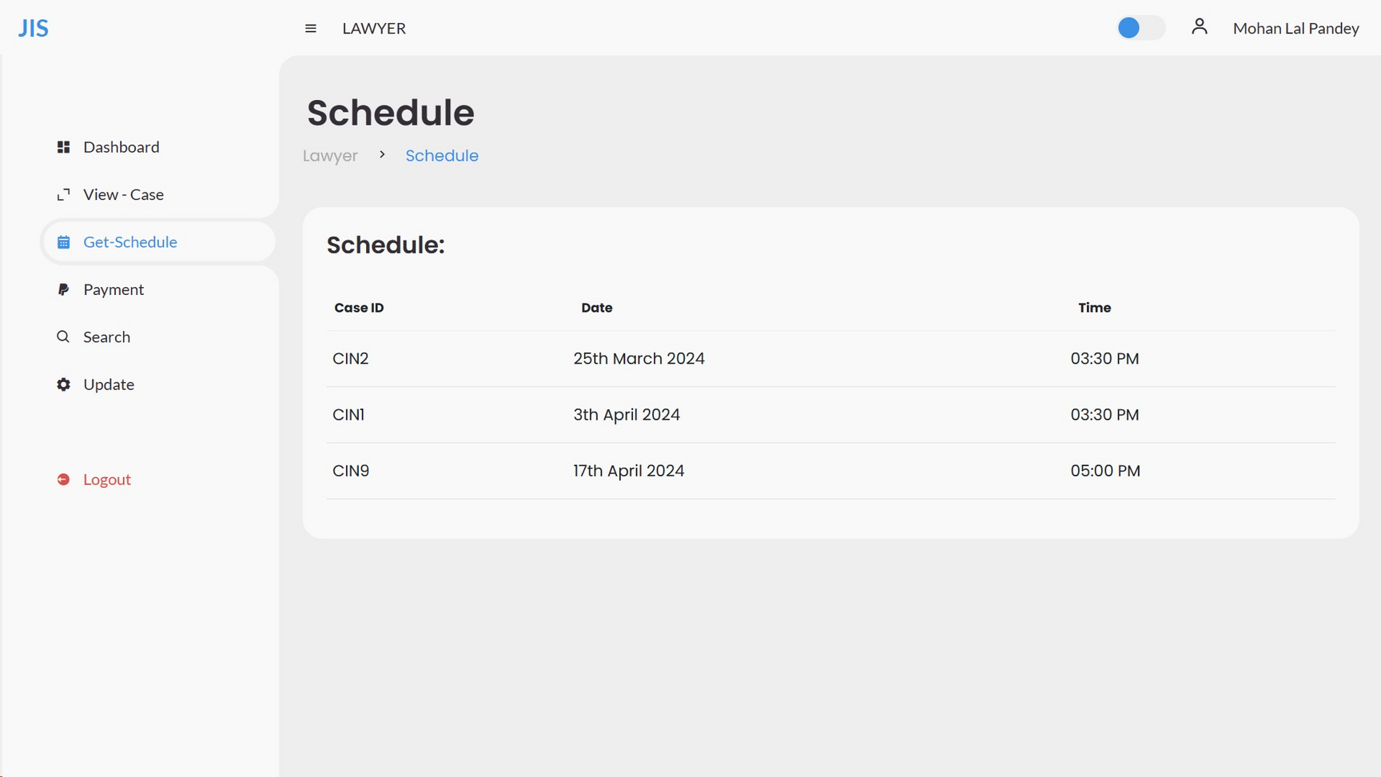
SCHEDULE

Slide 29
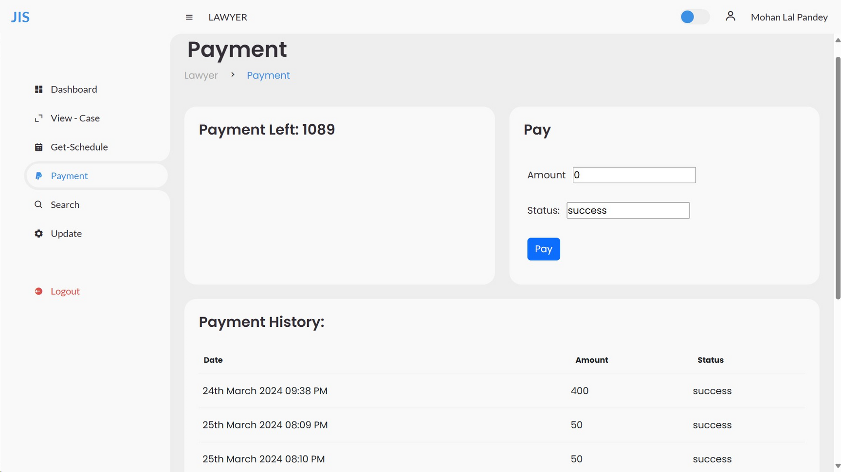
PAYMENT HISTORY

Slide 30
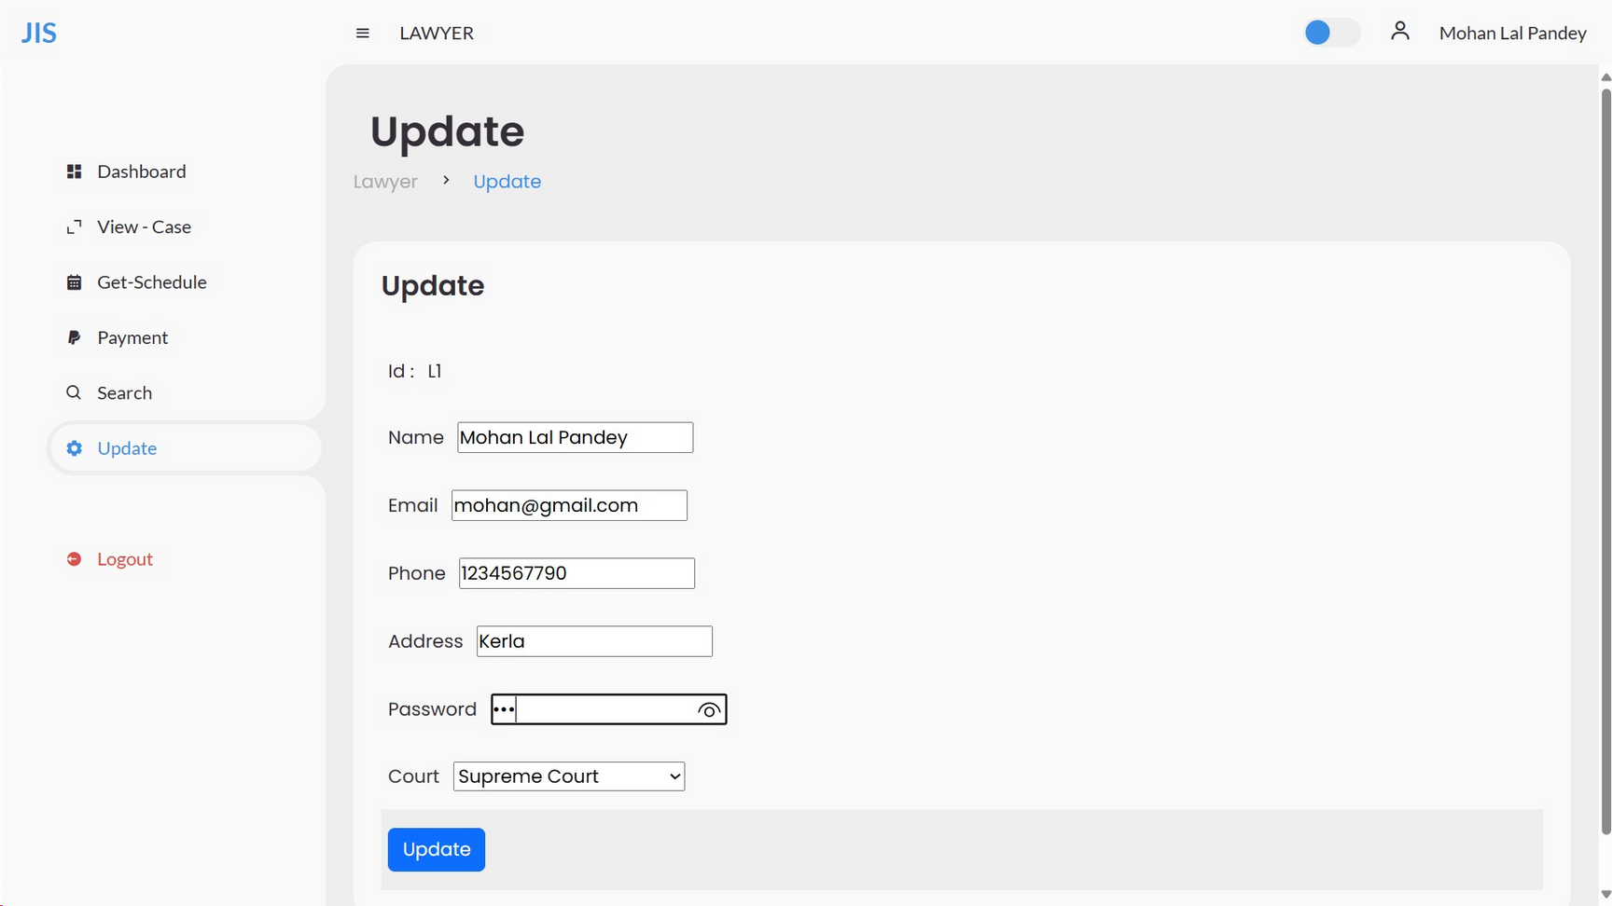
UPDATE LAWYER

Slide 31
JUDGE

Slide 32
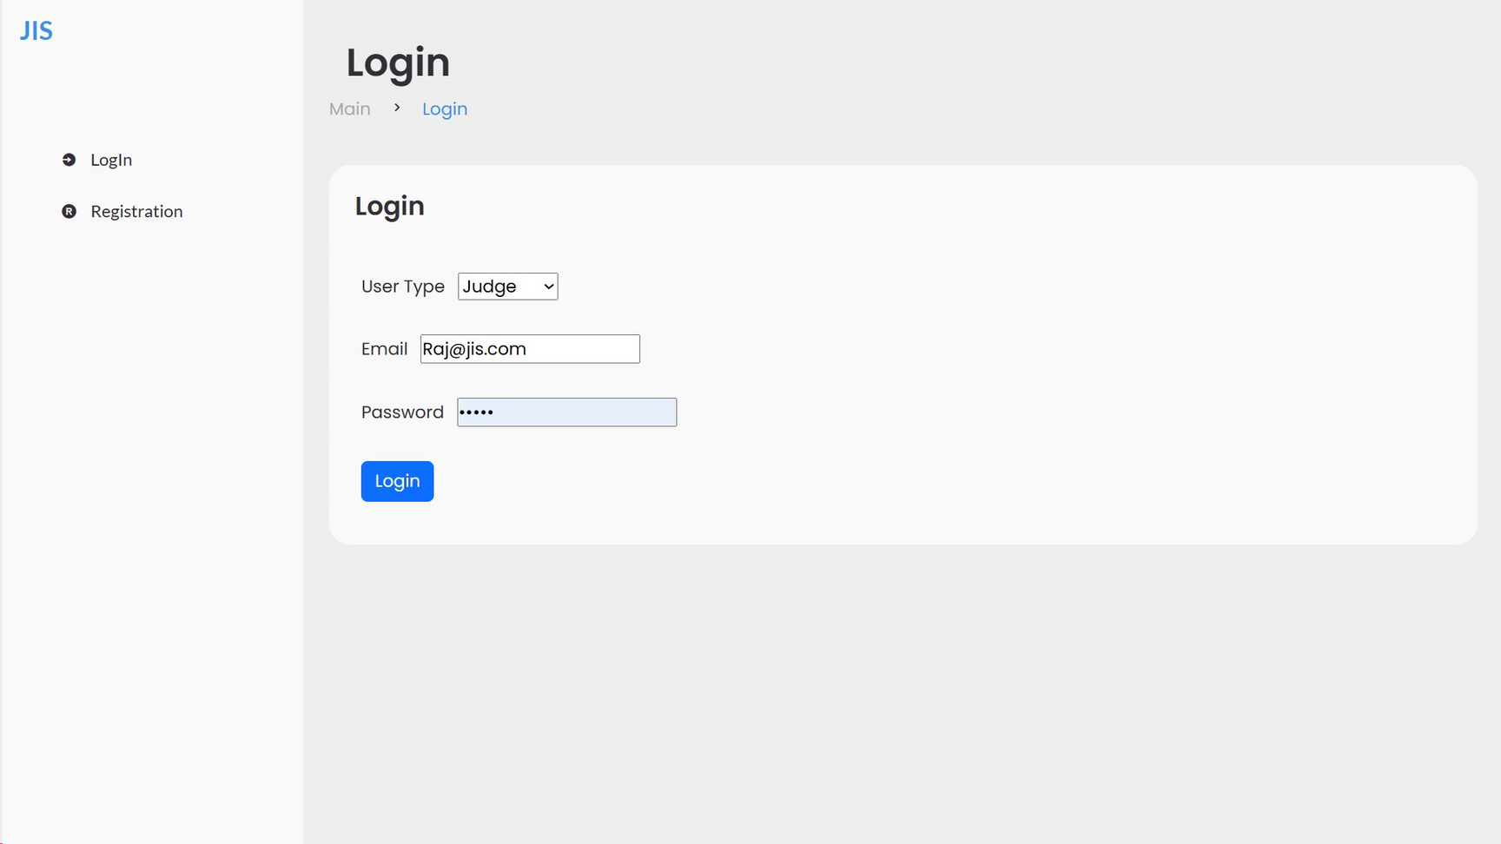
LOGIN

Slide 33
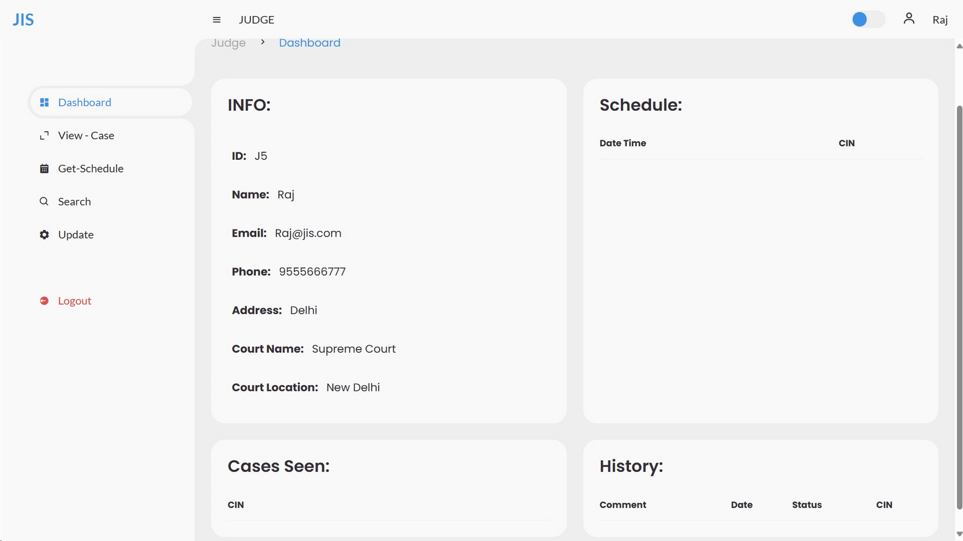
INFORMATION

Slide 34
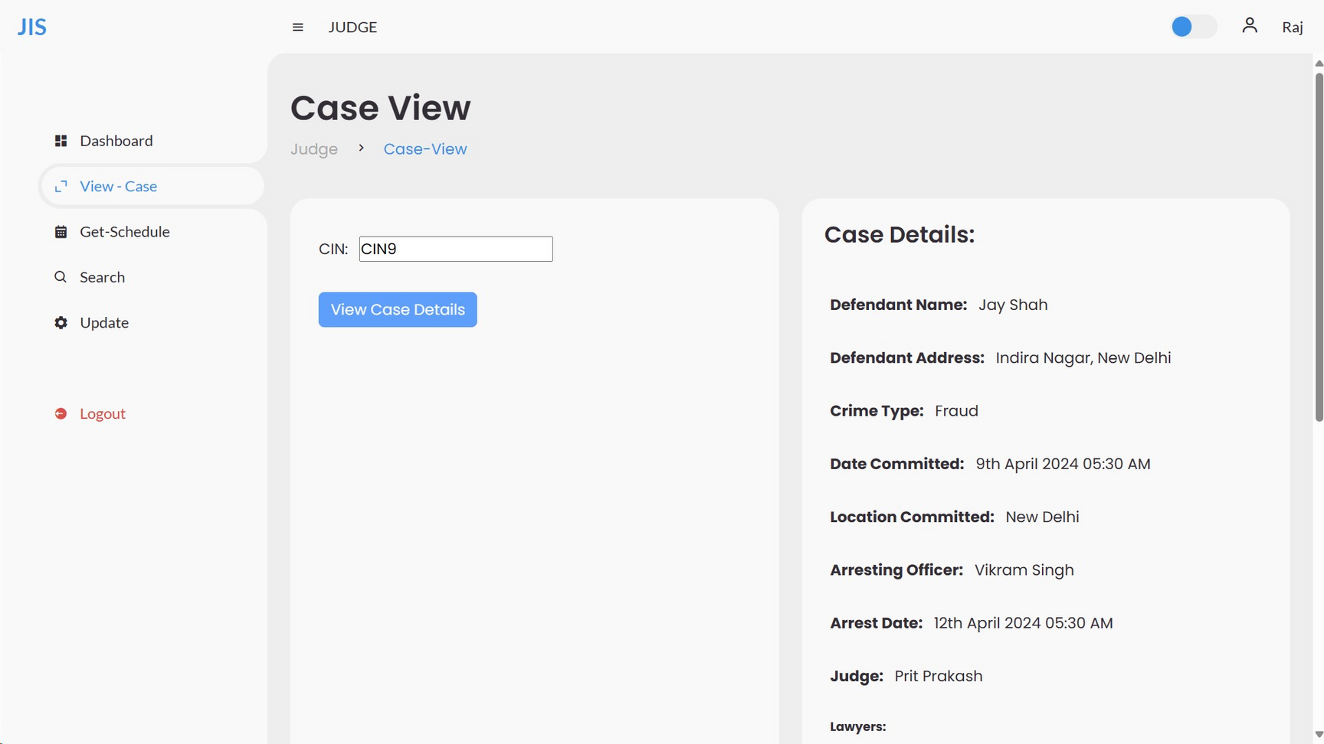
CASE VIEW

Slide 35
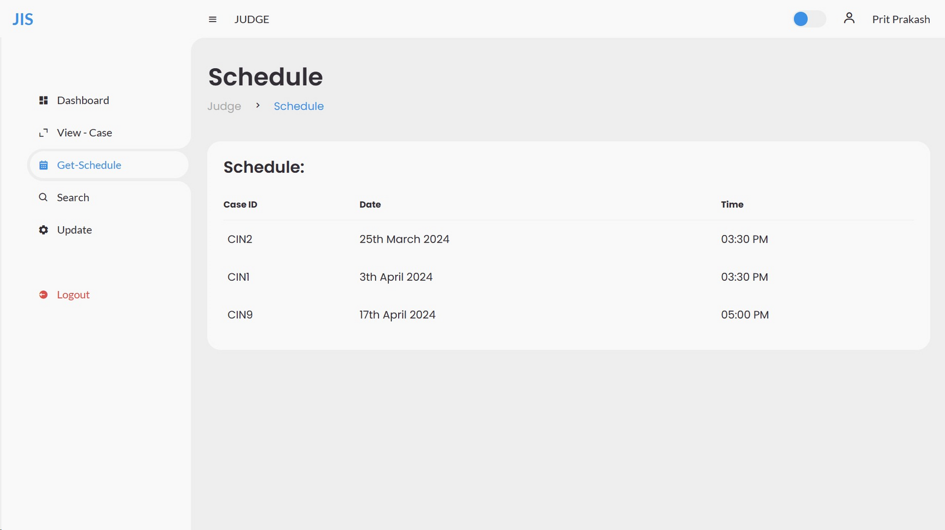
SCHEDULE

Slide 36
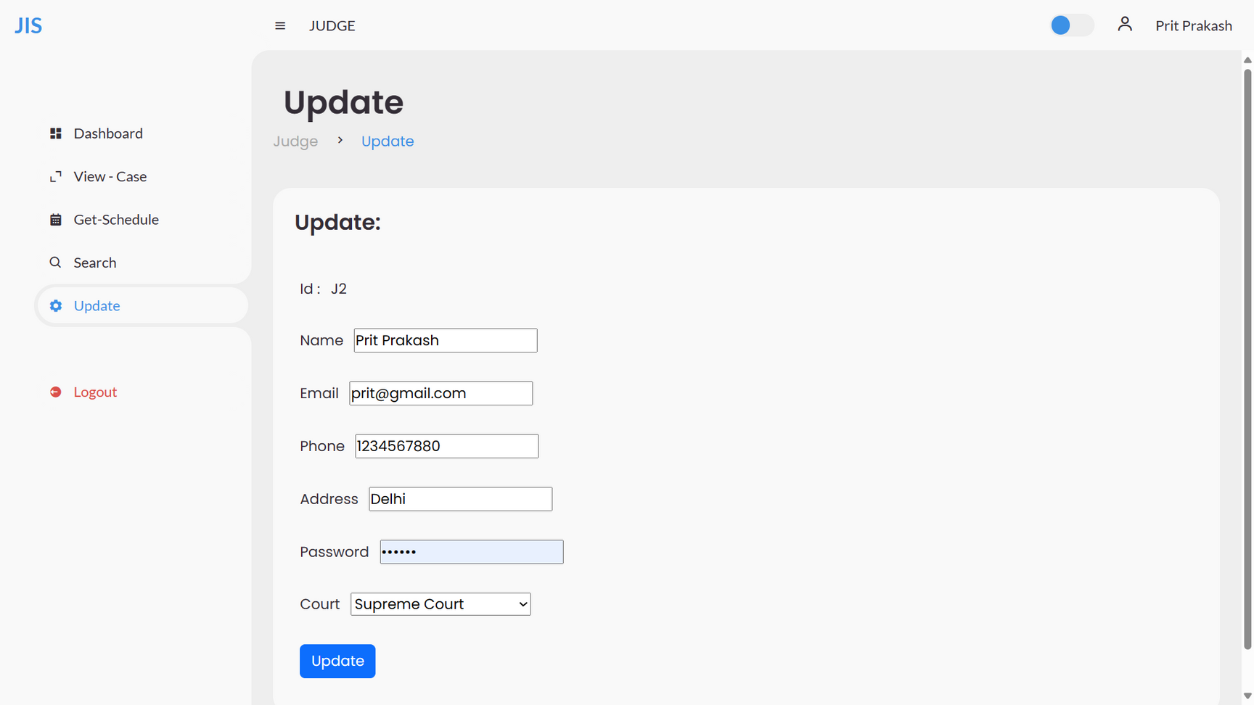
UPDATE

Slide 37

our team
Chandra Prakash
21JE0260
C. Sumana
21JE0263
B. Sai Anvith
21JE0247
B. Anil
21JE0252
Chahat Jain
21JE0257

Slide 38
THANK YOU

